Slide 1
BANK ACCOUNT MANAGEMENT
NAME:DINESH KUMAR.D
ENROLLMENT NO:EBEON1121460373

Slide 2
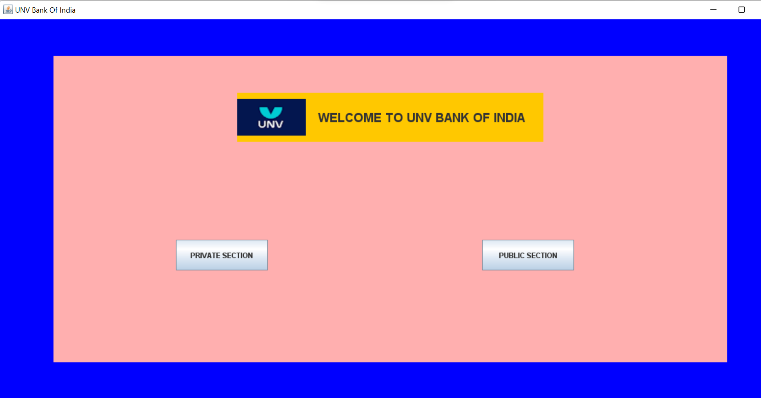
HOME PAGE
SWING is a GUI widget toolkit for java.It is a part of oracle java foundation classes-an API for providing a graphical user interface for java programs.

Slide 3
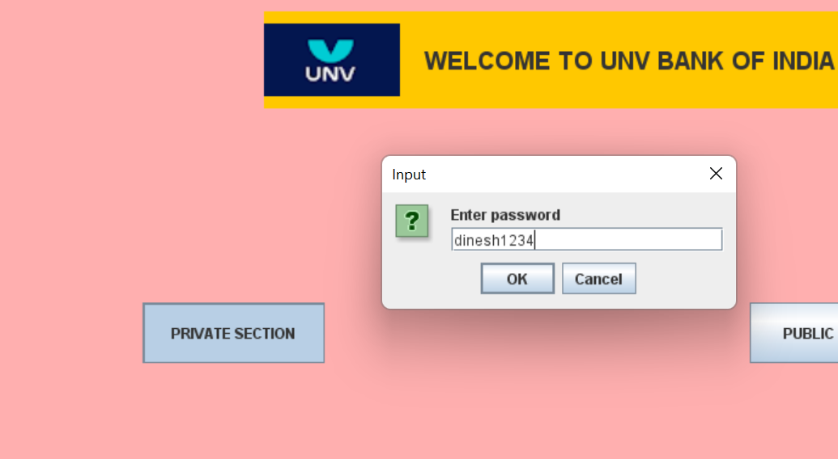
PASSWORD:dinesh1234
JFRAME: It is a top level container that provides a window on the screen .A frame is actually a base window on which other component on which other component namely,manu bar,panels,labels ,text field,buttons etc…

Slide 4
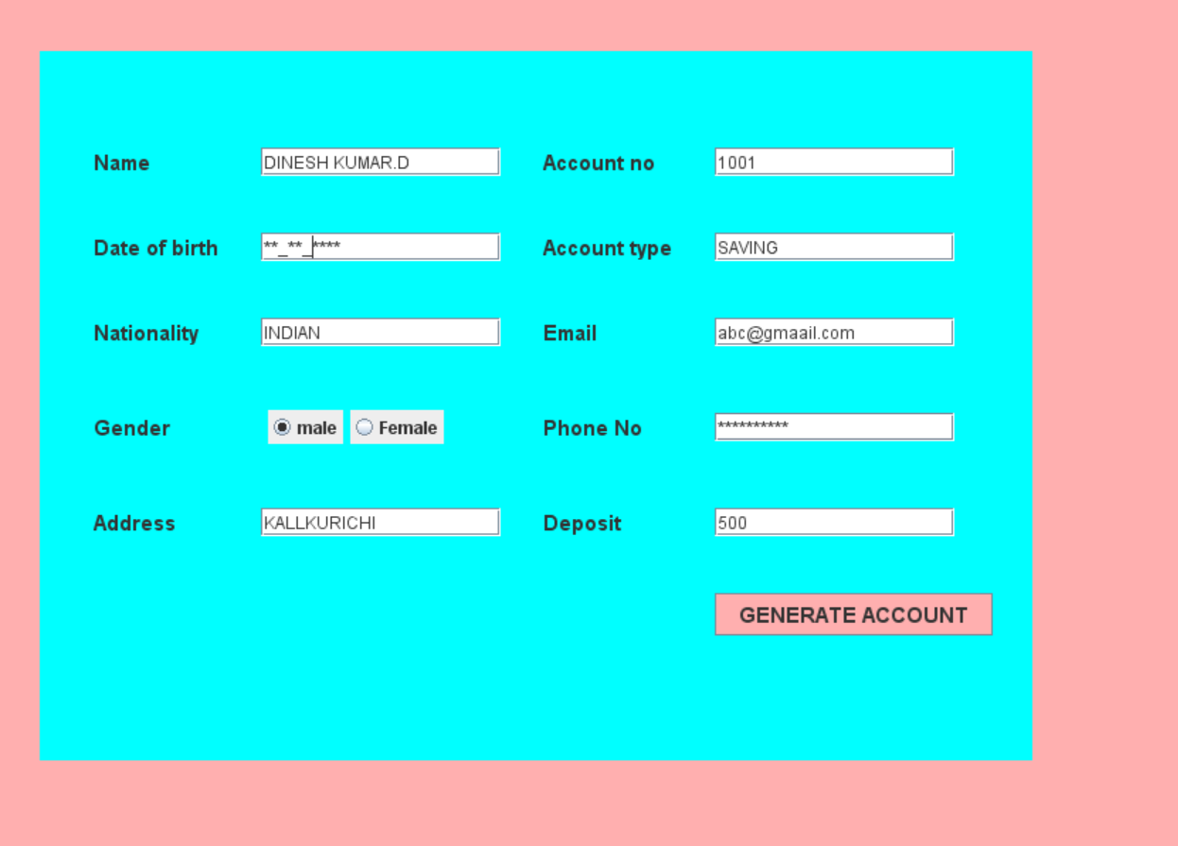
ACCOUNT OPENING FORM

Slide 5
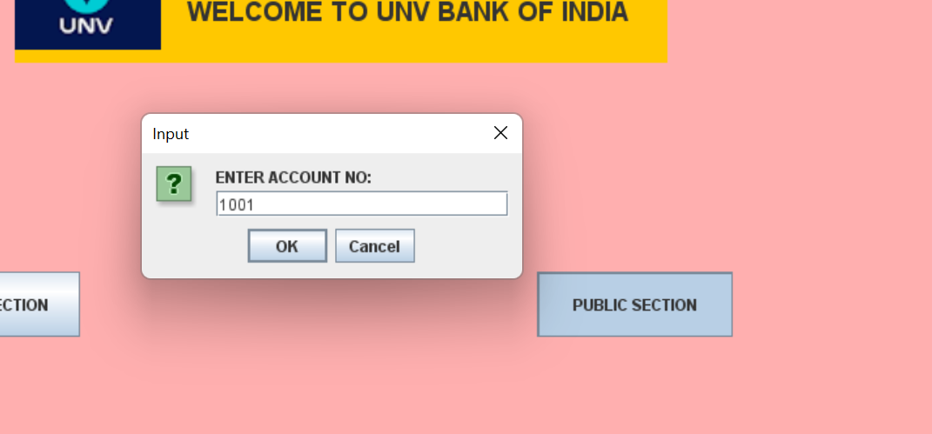
PUBLIC SECTION
CUSTOMER DETAILS

Slide 6
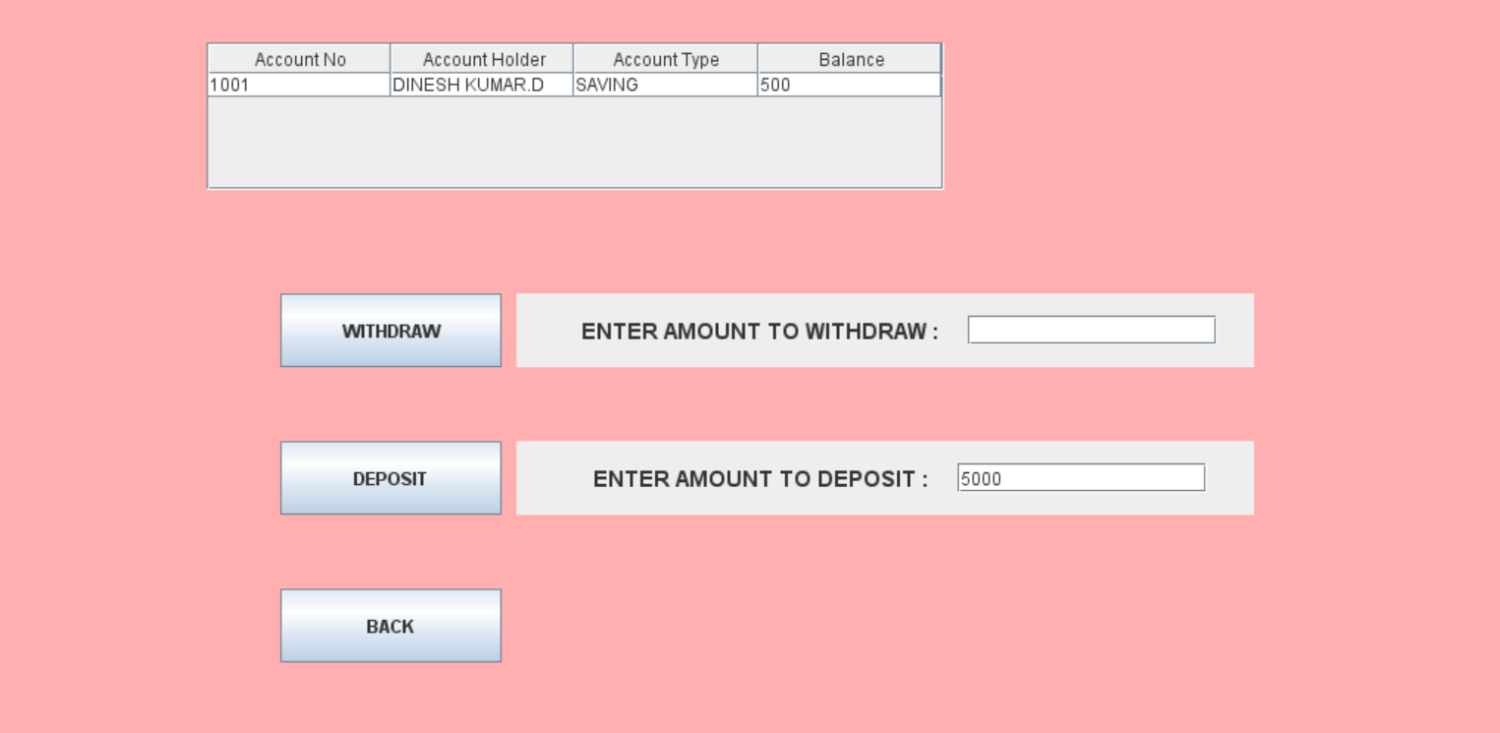
ACCOUNT HOLDER SECTION

Slide 7
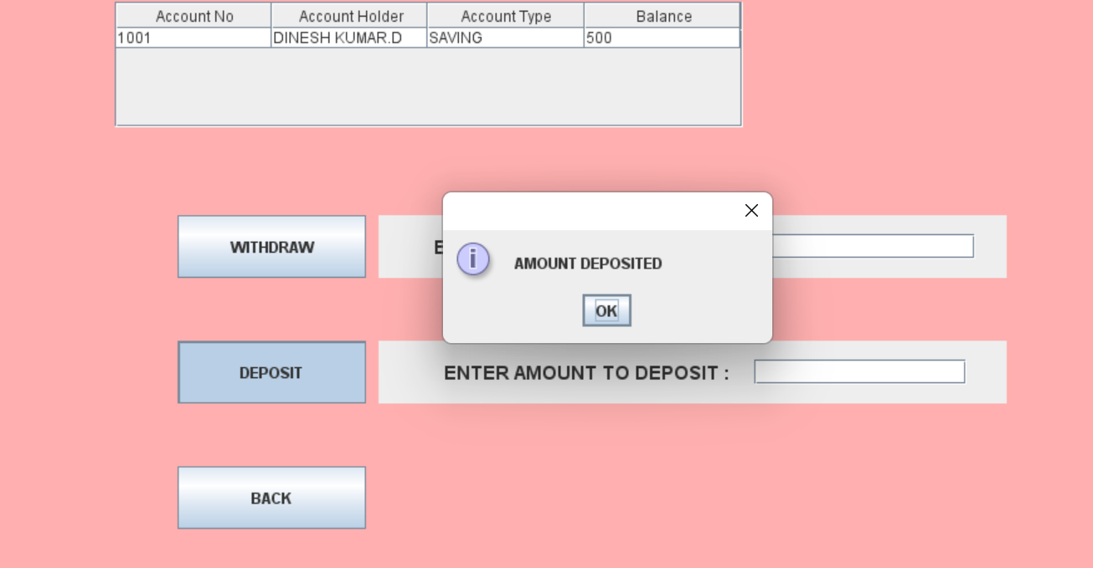
Message will show after withdraw or deposit by using showMessagedialog by using swing

Slide 8
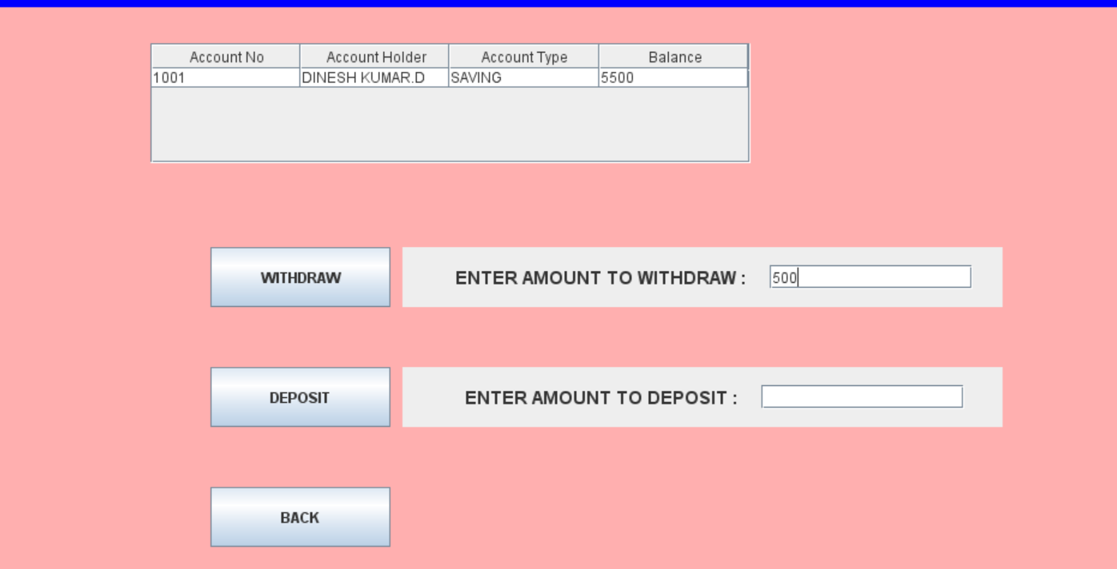

Slide 9
CREDIT AND DEBIT
GUI:Graphical User Interface,In java is an easy-to-use visual experience builder for java application.
JLABEL:a GUI display Area for a string of text,an image,or both.
JPANEL:A GUI component that function as a container to hold other components.
JBUTTON :A Button that perform an action when clicked on.
GRIDBAG LAYOUT:Is one of the flexible and complex-A GridBayLayout place the components in a grid of rows and column
JTEXTFIELD: A GUI textbox component that can be used to add,set or get text.
JRADIOBUTTON:One or more buttons in a group in which only 1 may be selected per group.

